Slide 1
Chapter 5
Bonds, Bond Valuation, & Interest Rates

Slide 2
Topics in Chapter
Key features of bonds
Bond valuation
Measuring yield
Assessing risk

Slide 3
Interest Rates & Interest-Bearing Securities
Interest rates:
Based on:
Driven by:
Role of:
Basis Point

Slide 4
Several Treasury Sales

Slide 5
Treasury Ups Sale Amount

Slide 6
Treasury Sales

Slide 7
Risk & Term Structure of Interest Rates
r_{d} = r* + IP + DRP + LP + MRP
r_{d} = Required rate of return on a debt security.
r* = Real risk-free rate.
IP = Inflation premium.
DRP = Default risk premium.
LP = Liquidity premium.
MRP = Maturity risk premium.

Slide 8
Risk & Term Structure
r = r* + IP + DRP + LP + MRP
r = nominal interest rate of a particular security
r* = real risk-free interest rate
IP = Inflation premium
DRP = Default risk premium

Slide 9
Risk & Term Structure
r = r* + IP + DRP + LP + MRP
LP = Liquidity Premium
MRP = Maturity Risk Premium

Slide 10
Premiums Added to r* (real risk-free rate) for Different Types of Debt
r = r* + IP + DRP + LP + MRP
ST Treasury:
LT Treasury:
ST corporate:
LT corporate:

Slide 11
Inflation & Interest Rates
Nominal Interest= 12%
- Inflation -1%
= Real Int. % =11%
Nominal Interest=
- Inflation
= Real Int. %
If inflation =
& req’d real return =
Then Nominal rate =? =

Slide 12
Relationship b/w Nominal & Real Interest Rates, & Inflation
Nom = Real + Inflation
But, inflation not additive, it grows or compounds, so multiply:
Is better determinant; known as Fisher effect

Slide 13
Estimating Inflation Premium (IP)
Treasury Inflation-Protected Securities (TIPS) are indexed to inflation.
IP for particular length maturity approximated as:
difference between yield on non-indexed Treasury minus yield on TIPS @ same maturity.

Slide 14
Bond Spreads, DRP, & LP
Bond spread:
is difference between corp. bond’s yield & Treasury yield of same maturity. Therefore:
Bonds of large, strong co.’s often have:
Bonds of small co.’s often have:

Slide 15
Computing Yields (i% or debt req’d return )
Start with base level of return all securities have
Calculate inflation premium (IP) for each future yr:
=
Then estimate (MRP) for each future year.
Finally, to get interest rate for non-Treasury debt, add in DRIP & LP.

Slide 16
Investors expect inflation of 5% next yr, 6% following yr, & 8% per yr thereafter.
Step 1: Find ave. expected inflation rate over years 1 to n:
IP₁ = 5%/1.0 = 5.00%.
IP₁₀ = [5 + 6 + 8(8)] /10 = 7.5%.
IP₂₀ = [5 + 6 + 8(18) ]/20 = 7.75%.
Must earn these IPs to break even vs. inflation;
that is, these IPs permit you to earn r* (before taxes).

Slide 17
Assume MRP is zero for Year 1 & increases by 0.1% each year.
Step 2: Find MRP based on this equation:
MRP_{t} = 0.1%(t - 1).
MRP₁ = 0.1% x 0 = 0.0%.
MRP₁₀ = 0.1% x 9 = 0.9%.
MRP₂₀ = 0.1% x 19 = 1.9%.

Slide 18
Step 3: Add IPs & MRPs to r*:
r_{treas} = r* + IP_{t} + MRP_{t}
R_{treas} = Quoted market interest rate
on treasury securities.
Assume r* (real risk-free) = 3%:
= r* + IP + MRP
R_{treas} =i%₁ = 3% + 5.0% + 0.0% = 8.0%.
=i%₁₀ = 3% + 7.5% + 0.9% = 11.4%.
=i%₂₀ = 3% + 7.75% + 1.9% = 12.65%.

Slide 19
Term Structure Yield Curve
Term structure of interest rates:
relationship between interest rates (or yields) & maturities.
Graph of term structure is a yield curve.

Slide 20
Hypothetical Treasury Yield Curve

Slide 21
What factors can explain shape of this yield curve?
Upward slope due to:
Increasing expected inflation
Increasing maturity risk premium
What about liquidity & default risk?

Slide 22
Treasury vs. Corporate Yield Curves relationships
Corp yield curves are higher than Treasuries, but not necessarily parallel.
Spread b/w two yield curves widens as corporate bond rating decreases due to:
DRP & LP

Slide 23
Upward vs. Downward sloping yield curves due to?
Real risk-free rate = 3%
Expected inflation for
Year 1 =7%, Yr 2 = 5%; Yr 3 = 3%
What are interest rates for 1, 2, & 3 yr borrowings?

Slide 24
Interest Rates & MRP Prob. 1
Real risk-free rate (r*) is 4% & inflation is expected to be 7% in Year1; 4% in yr 2; & 3% thereafter.
All Treasuries are highly liquid & free of default risk.
If 2-yr & 5-yr T-Bonds both yield 11%, what is difference in maturity risk premiums (MRPs) on two bonds; that is, what is MRP₅ – MRP₂?

Slide 25
Interest Rates & Inflation Prob. 2
Due to recession, rate of inflation expected for coming year is only 3.5%. However, rate of inflation in Yr 2 & thereafter is expected to be constant at some level above 3.5%. Assume real risk-free rate (r*) = 2% for all maturities, & there are no maturity premiums. If 3-year T-Bonds yield 3% (0.03) more than 1-year T-Bonds, what rate of inflation is expected after year 1?

Slide 26
Coupon Bonds
Bond = Debt = Borrowing
Fixed Maturity (Maturity Date) = N
Par Value=Face Value=Maturity Value=$1000=FV
Coupon Rate=Stated Rate (locked in in bond contract)
Coupon payment= Coupon rate x face value=PMT
Market Rate of interest = Yield to Maturity = rate used to discount bond CF’s = I
**PV cash flow of bonds always opposite sign of PMT & FV!!!

Slide 27
Bond Certificate

Slide 28
Bond Perspectives
Debt
Asset
Needs $
Borrower
Issuer or seller
Debtor
Cost of borrowing
Interest Paid (Expense) – generates tax benefit (Svgs)
Cost of Debt
= R_{d} or K_{d};
After-tax cost = R_{d} (1-t)
Has $
Lender
Buyer or Investor
Bondholder
Creditor
Requires return to invest $ in bonds based on risk
Interest Received (earned) (Revenue) - pay tax on it
Capital Appreciation

Slide 29
Key Features of Bond
Maturity:
Issue date:
Default risk:
In marketplace, bond price quoted as % of par:

Slide 30
Value of Financial Security
Value of any asset based on:
NPV of expected future CFs discounted by an i% (interest or discount rate) that reflects risk factors
That i% depends on:
Riskiness of CFs
General level of interest rates, which

Slide 31
Value of 10-yr, 10% coupon bond if: mrkt i% = 10%
0
1
2
10
10%
...
V = ?
100
100
100 + 1,000
$100
$100
$1,000
V
=
+
.
.
.
+
+
B
(1 + i)¹
(1 + i)^{N}
(1 + i)^{N}
= $90.91 + . . . + $38.55 + $385.54
= $1,000.

Slide 32
Bond consists of 10-yr, 10% annuity of $100/yr plus $1,000 lump sum at t = 10:
PV annuity
PV maturity value
Value of bond
$ 614.46
385.54
$1,000.00
=
=
=
INPUTS
10 10 100 1000
N I/YR PV PMT FV
-1,000
OUTPUT

Slide 33
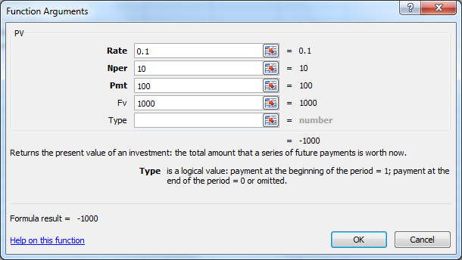
Bond Pricing in Excel

Slide 34
What happens if expected inflation rose by 3%, increasing mrkt i = 13%?
INPUTS
? ? ? ?
N I/YR PV PMT FV
???
OUTPUT
When market interest rate (i)rises above coupon rate, bond’s value (PV or price) falls below par, so sells @ discount.

Slide 35
What happens if 1-yr passes but market i stays at 13%?
INPUTS
N=? 13 100 1000
N I/YR PV PMT FV
???
OUTPUT

Slide 36
What happens if 2nd yr passes but market i stays at 13%?
INPUTS
N=? 13 100 1000
N I/YR PV PMT FV
???
OUTPUT

Slide 37
What happens if 9 yrs pass but market i stays at 13%?
INPUTS
N=? 13 100 1000
N I/YR PV PMT FV
???
OUTPUT
As a bond approaches maturity, price approaches face or maturity value of $1000

Slide 38
W/ 10-yrs to maturity, what happens if inflation fell, & i% declined to 8%?
INPUTS
10 i=? 100 1000
N I/YR PV PMT FV
???
OUTPUT
If coupon rate > mrkt i% (r_{d}),
price rises above par, & bond sells at premium.
PV = ? =

Slide 39
Bond Pricing in Excel
Years to Mat: | 10
Coupon rate: | 10%
Annual Pmt: | $100
Par value = FV: | $1,000
Going rate, i%: | 8%
PV = ? =

Slide 40
Summary of Bond price & interest rate relationships
If market i% increases above stated (coupon) rate,
If market i% drops below stated (coupon) rate,
Market i% & Bond PRICE move
INVERSELY !

Slide 41
Bond prices & changing interest rates
Suppose bond was issued 20 years ago & now has 10 yrs to maturity.
What happens to its value over time if required rate of return remained at 10%, or at 13%, or at 7%?

Slide 42
Bond Value ($) vs Years remaining to Maturity
1,372
r_{d} = 7%.
1,211
r_{d} = 10%.
1,000
M
837
r_{d} = 13%.
775
30 25 20 15 10 5 0

Slide 43
Bond Price Movements over time
At maturity, value of any bond must equal its par value.
Value of premium bond decreases to $1,000.
Value of discount bond increases to $1,000.
A par bond stays at $1,000 if mrkt i% (r_{d})remains constant.

Slide 44
What’s market value of 10-yr, 10% coupon bond when market = 7%?
INPUTS
?= ?= ?= ?= =
N I/YR PV PMT FV
???
OUTPUT
Bond sells at a premium::
Price today = ???

Slide 45
If buy 10%, 10-yr bond today for $1,210.71, & hold it to maturity, what’s rate of return?
INPUTS
?= ?= ?= ?=
N I/YR PV PMT FV
???
OUTPUT
Solve for i% = ??? = Yield to maturity (YTM)

Slide 46
What’s “yield to maturity”?
YTM is rate of return earned on bond held to maturity.
It assumes bond will not default.
Includes both:
Interest rate equating bond price today to NPV of PMTs & FV.
Vs. Annualized Return which reflects only 1-yr holding period

Slide 47
On 10-yr. 9% annual coupon, $1,000 par value bond selling for $1,134.20, what’s YTM?
0
1
9
10
i% =?
...
Pmt
Pmt
Pmt
PV₁
.
.
.
PV₁₀
PV_{M}
FV
=Price today
Find i % (r_{d}) that “works”!

Slide 48
On 10-yr. 9% coupon bond selling for $1,134.20. What’s YTM?
INPUTS
?= ?= ?= ?=
N I/YR PV PMT FV
???
OUTPUT
Sells @ premium.
Because coupon = 9% >
mrkt i% =??? %,
bond’s price (PV) > par.

Slide 49
On 10-yr. 9% annual coupon, $1,000 par value bond selling for $1,134.20, what’s YTM?
0
1
9
10
i% =?
...
90
90
90
PV₁
.
.
.
PV₁₀
PV_{M}
1,000
1134.20
So i% (YTM) = ??

Slide 50
On 10-yr. 9% coupon bond selling for $887. Find YTM (i % or r_{d})
INPUTS
?= ?= ?= ?=
N I/YR PV PMT FV
???
OUTPUT
Sells @ discount.
Because coupon = 9% <
mrkt i% = ??
bond’s value < par.

Slide 51
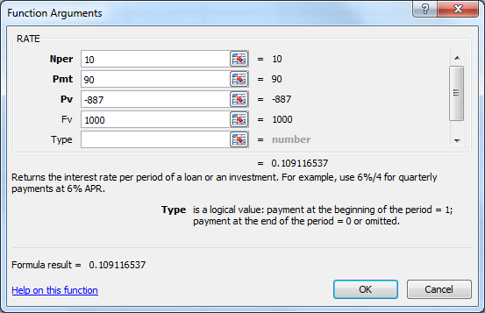
Find YTM (i % or r_{d})
Years to Mat: | N = 10
Coupon rate: | 9%
Annual Pmt: | Pmt = $90.00
Current price: | PV = <$887.00>
Par value = FV: | FV = $1,000.00

Slide 52
Bond Prices & Int. Rates
If coupon rate < mrkt i % (r_{d}) bond sells @
If coupon rate = i %, bond sells @
If coupon rate > i%, bond sells @
If market i% rises,
@ maturity

Slide 53
Definitions
Current yield = “Interest Yield”
Capital gains yield =Change in value
= YTM = +
Exp total
return
Exp
Curr yld
Exp cap
gains yld

Slide 54
Definitions
Annual coupon pmt
Current price
Current yield =
Capital gains yield =
= YTM = +
Change in price
Beginning price
Exp total
return
Exp
Curr yld
Exp cap
gains yld

Slide 55
9% coupon, 10-year bond, P = $887, & YTM = 10.91% What’s current yield?
Current yield =
=

Slide 56
YTM = Current yield + Cap gains yield
Cap gains yield = YTM - Current yield
=
Could also find values in Years 1 & 2,
get difference, & divide by value in
Year 1. Same answer.

Slide 57
Semiannual Bonds
1. Multiply years by 2 to get periods = 2N.
2. Divide nominal rate by 2 to get periodic rate = i%/2.
3. Divide annual INT by 2 to get PMT = INT/2.
INPUTS
2N i%/2 OK INT/2 OK
N I/YR PV PMT FV
OUTPUT

Slide 58
Value of 10-year, 10% coupon, semiannual bond if mrkt i% = 13%
? ? ? ?
N I/YR PV PMT FV
???
INPUTS
OUTPUT

Slide 59
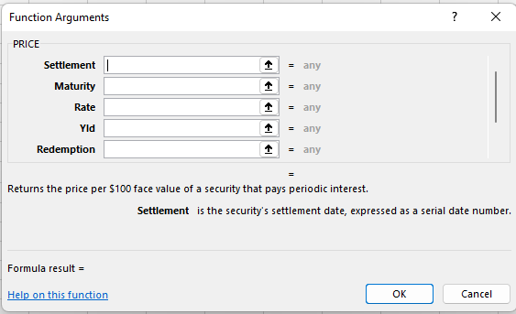
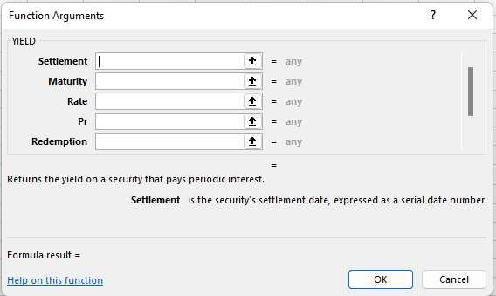
Spreadsheet Functions for Bond Valuation (w/ actual dates & day-counts)
PRICE >
YIELD

Slide 60
Call Provision
Issuer can refi if rates drop.
T/4, on callable bonds:
Most bonds have deferred call & declining call premium
Yield to call:

Slide 61
Callable Bonds & Yield to Call YTC)
A 10-year, 10% semiannual coupon bond is selling for $1,135.90 with an 8% YTM.
Can be called after 5 yrs. with a 5% call premium.
What’s the YTC?

Slide 62
Nominal Yield to Call (YTC) (solve for i%)
INPUTS
? ? ? ?
N I/YR PV PMT FV
???
OUTPUT

Slide 63
If bought bonds, more likely to earn YTM or YTC?
Coupon rate = 10% vs. YTC = r_{d} = 7.53%.
Could raise $$ by selling new bonds which pay 7.53%.
Could thus replace bonds which pay $100/yr with bonds paying only $75.30/year.
Investors should expect a call,
hence would earn YTC = 7.53%, not YTM = 8%.

Slide 64
Investor returns on callable bonds
If bond sells @ premium, then:
coupon > market rate,
so a call is likely.
So, investors expect to earn:
YTC on premium bonds.
YTM on par & discount bonds.

Slide 65
What’s sinking fund?
Provision to pay off loan over its life rather than all @ maturity.
Similar to amortization on a term loan.
Reduces investor risk as shortens ave maturity.
But not good for investor if rates drop after issuance

Slide 66
Sinking funds generally handled 2 ways
Call x% @ par per yr for sinking fund purposes.
Buy bonds on open market:

Slide 67
Sinking Fund Redemption

Slide 68
Bond Ratings |  | % defaulting within:
S&P & Fitch | Moody’s | 1 yr. | 5 yrs.
Investment grade bonds:
AAA | Aaa | 0.0 | 0.0
AA | Aa | 0.0 | 0.1
A | A | 0.1 | 0.6
BBB | Baa | 0.3 | 2.9
Junk bonds:
BB | Ba | 1.4 | 8.2
B | B | 1.8 | 9.2
CCC | Caa | 22.3 | 36.9
Source: Fitch Ratings

Slide 69
Bond Ratings & Bond Spreads
Long-term Bonds | Yield (%) | Spread (%)
10-Year T-bond | 2.68
AAA | 5.50 | 2.82
AA | 5.62 | 2.94
A | 5.79 | 3.11
BBB | 7.53 | 4.85
BB | 11.62 | 8.94
B | 13.70 | 11.02
CCC | 26.30 | 23.62

Slide 70
Factors affecting default risk & bond ratings (1)
Financial ratios
(More…)

Slide 71
Bond Ratings Median Ratios (S&P)
 | Interest coverage | Return on capital | Debt to capital
AAA | 23.8 | 27.6% | 12.4%
AA | 19.5 | 27.0% | 28.3%
A | 8.0 | 17.5% | 37.5%
BBB | 4.7 | 13.4% | 42.5%
BB | 2.5 | 11.3% | 53.7%
B | 1.2 | 8.7% | 75.9%
CCC | 0.4 | 3.2% | 113.5%

Slide 72
Other Factors Affecting Bond Ratings (2)
Provisions in bond contract
(More…)

Slide 73
Other Factors Affecting Bond Ratings (3)

Slide 74
Interest rate (or price) risk for 1-year & 10-year 10% bonds
Interest rate risk: Rising mrkt i % (r_{d}) causes bond’s price to fall.
i %
1-year
Change
10-year
Change
5%
$1,048
$1,386
4.8%
38.6%
10%
1,000
1,000
4.4%
25.1%
15%
956
749

Slide 75
Value
1,500
10-year
1,000
1-year
500
r_{d}
0
0%
5%
10%
15%

Slide 76
What’s reinvestment rate risk?
Risk that CFs have to be reinvested @ future lower rates, reducing income.
Illustration:
Suppose just won $500,000 playing lottery.
You’ll invest money & live off interest, so buy 1-year bond with 10% YTM.

Slide 77
What’s reinvestment rate risk? (Con’t)
Year 1 income = $50,000.
And @ year-end get back $500,000 to reinvest.
Now, if rates fall to 3%, income drops from $50,000 to $15,000.
But if bought 30-yr bonds, income would remain constant @ $50k per yr.

Slide 78
Maturity Risk Premium
L/T bonds:
S/T bonds:
Nothing is riskless!
Yields on longer term bonds usually are greater than on shorter term bonds,

Slide 79
Other types of Bonds
Zero coupon:
Convertible:
Income:

Slide 80
Other types of Bonds
Revenue:
Floating rate:

Slide 81
Bankruptcy
Two main chapters of Federal Bankruptcy Act:
Typically,
company wants:
creditors may prefer:

Slide 82
Bankruptcy (Con’t)
If company can’t meet its obligations, it files under Chapter 11.
Stops creditors from foreclosing, taking assets, & shutting down business.
Company has 120 days to file a reorganization plan.
Court appoints a “trustee” to supervise reorganization.
Management usually stays in control.

Slide 83
Bankruptcy (Con’t)
Company must demonstrate in its reorganization plan that it is “worth more alive than dead.”
Otherwise, judge will order liquidation under Chapter 7.

Slide 84
If company is liquidated, here’s payment priority:
Past due property taxes
Secured creditors from sales of secured assets.
Trustee’s costs
Expenses incurred after bankruptcy filing
Wages & unpaid benefit contributions, subject to limits
Unsecured customer deposits, subject to limits
Taxes
Unfunded pension liabilities
Unsecured creditors
Preferred stock
Common stock

Slide 85
If company is liquidated, here’s payment priority: (Con’t)
In a liquidation, unsecured creditors generally get zero. This makes them more willing to participate in reorganization even though their claims are greatly scaled back.
Various groups of creditors vote on reorganization plan. If both majority of creditors & judge approve, company “emerges” from bankruptcy with lower debts, reduced interest charges, & a chance for success.

